Slide 1
CDB Aviation Overview
Apr 2026

Slide 2



Full-Service Aircraft Leasing Platform With Global Footprint
CDB Aviation
At a Glance
507
Aircraft
Current Fleet & Committed
>80%
New-Gen Aircraft
By Aircraft Value
Moody’s: A1
CDB Aviation is a full-service aircraft leasing platform 100% owned by CDB Leasing with a global footprint, offering airline customers a suite of fleet solutions:
New and used aircraft leases
Sale / leasebacks and financing
We are backed by China Development Bank, China’s largest development bank, and one of the world’s largest institutions supporting domestic and foreign infrastructure projects.
Fitch: A
Average Aircraft Age
5.7 Years
S&P: A
US$17Billion
Total Assets
Remaining Lease Term
7.4 Years
87
Airline Customers
44
Countries & Regions
TOP 10
Lessor Market Position
Dublin, Ireland Headquarters
US$12
Billion
Contracted Minimum Rentals
Through 2039
121
Staff Members
From 16 countries
& regions
Note: Numbers are as of 31 Dec 2025, except that the Moody’s rating of “A1” is updated as of 25 Mar 2026.
2

Slide 3









Quasi-Sovereign Credit, 100% Owned by CDB Leasing
Sole Aircraft Leasing Arm of CDB Bank
Strong Credit Rating
Strong Parent Support
Regulatory Requirement to Provide Liquidity Support
Rating Agencies | China | CDB Bank | CDB Leasing | CDB Aviation
 | A1 | A1 | A1 | A1
 | A | A | A | A
 | A+ | A+ | A | A
China Development Bank
(“CDB”)
Other Shareholders
Back-up Intercompany RCFs to Support Growth
35.6%
64.4%
China Development Bank Financial Leasing Co., Ltd
(“CDB Leasing”) [1606.HK]
Credit Enhancement
Aircraft Ownership
100%
100%
Great Support on OEM Orderbook
CDB Aviation Lease Finance Designated
Activity Company
(“CDB Aviation”)
Aircraft Leasing Platform
Shared Services & Cost Synergies
Aircraft Management
Aircraft Ownership & Management
100%
Aircraft Owning Entities
(Off-shore)
Aircraft Owning Entities
(On-shore)
Strategic Oversight
Note: Moody’s upgraded CDBALF’s rating from A2 to “A1” on 25 Mar 2026.
3

Slide 4
One of the Core Business Segments of CDB Leasing
Aircraft Leasing (28%)
Ship Leasing (15%)
One of China’s largest and most diversified ship leasing platforms, with 236 vessels in operation (including 201 under operating leases), featuring a young fleet, high utilisation and flexible asset allocation, supported by disciplined asset rotation and proven value realisation capabilities
The first financial leasing company in China to establish an overseas aviation specialty subsidiary (CDB Aviation)
Owned and committed fleet totals 507 aircraft and engines, comprising a young, next‑generation fleet with a sizable and well‑phased order backlog.
Energy Leasing (22%)
An industry-leading energy leasing platform with sustained partnerships across wind power, photovoltaic, hydropower, energy storage, etc.
Proved large-scale project execution capabilities and a well‑established presence supporting China’s energy transition.
High-End Equipment
Leasing (20%)
Focused on high‑end manufacturing and strategic emerging industries, supporting industrial upgrading and new‑quality productive forces across China.
Maintains a broad nationwide footprint, serving clients along key industrial value chains through targeted, industry‑finance integrated leasing solutions.
Inclusive Finance and Others (15%)
A comprehensive inclusive finance platform covering vehicles, construction machinery and agricultural equipment
Supported over 200,000 end clients nationwide, maintaining broad access across SMEs and individual operators
USD Business
v.s.
RMB Business
43%
57%
(%) represents leasing asset contribution
4

Slide 5
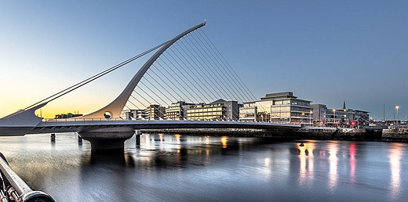





































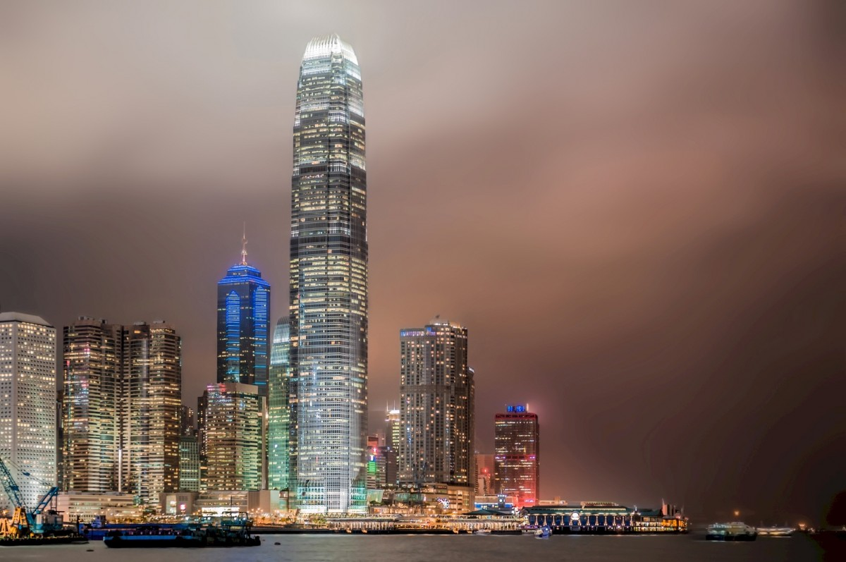






































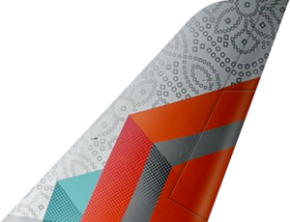











Global Presence, International Expertise: Serving Airlines Across the World
87
LESSEES
Dublin (HQ)
EMEA
Greater China
44
JURISDICTIONS
AMERICAS
HK & Shenzhen
30%
27%
22%
ASIA PACIFIC
(EXCL. Greater China）
21%
(%) represents lease revenue contribution as of 31 Dec 2025.
With innovative financing solutions and direct access to a robust orderbook of the most advanced and fuel-efficient aircraft, we are well-positioned to support airlines across the world’s fastest-growing air travel markets.
5

Slide 6
Resilient Portfolio, Strategic Orderbook, Committed Cashflow
In-Demand & Fuel-Efficient Aircraft Portfolio
Well-Laddered Lease Expiries
507
(Owned & Committed
Aircraft & Engines)
453 Narrowbody
(89% by Aircraft Number)
372 New-Gen
(73% by Aircraft Number)
Young Fleet with Long Remaining Lease Terms Among Peers
5.7Y
Weighted Average Age¹
7.4Y
Weighted Average
Remaining Lease Term¹
Note: 1. Based on 321 owned aircraft (excluding engines) as of 31 Dec 2025.
Source：2025 annual reports or latest performance releases of each company
6
7

Slide 7
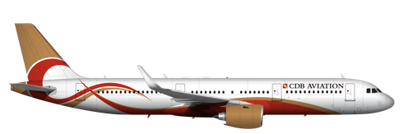




Resilient Portfolio, Strategic Orderbook, Committed Cashflow
Committed Airbus & Boeing Narrowbody Aircraft and Entitlements With COMAC
181
Committed
Non-Binding Entitlements
181 Stream & Steady Backlog for Airlines
Contracted minimum rentals through 2039
$12Bn
Note: 100% of aircraft committed for 2026-2027 are placed.
7

Slide 8

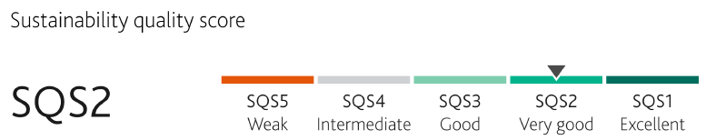









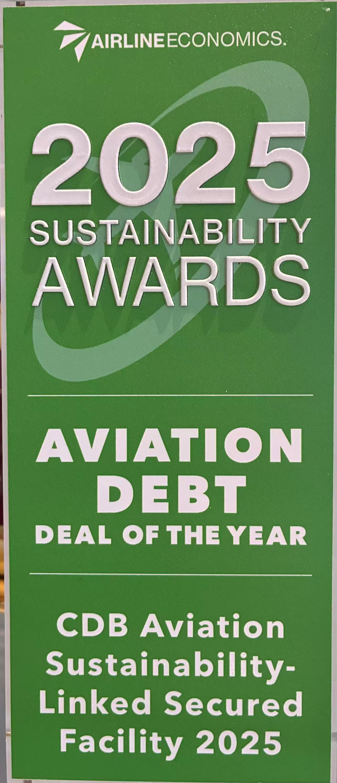










Proven Financing Capabilities
Diversified Funding at Competitive Rates
Notable ESG Financing
2023 $625m 3Y Unsecured SLL
CA-CIB, HSBC, Natixis, etc.
2024 $506m 3Y Unsecured SLL
CA-CIB, BOC HK, BOCOM, ABC London, etc.
2024 $685m 7Y SLL Secured Port
CA-CIB, BNP Paribas, Natixis, KDB, HSBC, Caixa Bank, etc.
Ishka - Most innovative Deal of 2023
Airline Economics – Debt Deal of the Year 2024
2025 $710m 5Y Unsecured SLL
2025 $610m 5Y Unsecured SLL
CA-CIB, BNP Paribas, Natixis, KDB, HSBC, Caixa Bank, etc.
Airline Economics – Sustainability-linked Secured Facility 2025
CA-CIB, BOC HK, ICBC Asia, BOCOM, CITIC International, CTBC, etc.
Lender Geographic Diversification
（Excl. Global Bonds)
Long-term partnerships with over 50 banks
Loan Types
Major Sustainability KPIs
  Carbon dioxide (CO2) Emissions Intensity: Grams of CO2 per Available Seat Kilometers
  Share of New Generation Aircraft in CDB Aviation’s owned and managed Group Fleet
Unsecured VS. Secured
Funding Access to Leading Financial Institutions
(Selected)
Recognized for Sustainability Excellence
As of 31 Dec 2025, CDB Aviation has over US$2Bn available credit lines with external banks.
2024 - Most Innovative Deal of 2023: Ishka
2024 - Sustainable Finance Deal of the Year
2025 – Aviation Debt Deal of the Year - Sustainability-linked Secured Facility
8

Slide 9

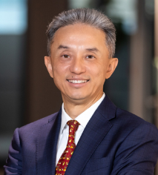




Strong Global Management Team
BOARD OF DIRECTORS
Average 26+ years of experience across lessors, airlines, OEMs and financial institutions
Hong MA, Chairwoman
>30 years in banking and leasing in CDB Bank Group
Jie CHEN, Director
>35 years in aircraft leasing business, previously worked at ALC and ILFC
Yu CHEN, Director
>25 years in banking and leasing business in CDB Bank Group
Alan GERAGHTY, Independent Director
>20 years in financial services industry
Stephen KAVANAGH, Independent Director
previous CEO of Aer Lingus, 30 years at the Irish flag carrier
Chris QUINN, Independent Director
>30 years in aviation and asset financing and leasing sector
MANAGEMENT
TEAM
Average 25+ years of experience in aviation, aircraft leasing and financing
Jie Chen,
CEO
>35 years in aircraft leasing business, previously worked at ALC and ILFC
Fiona Scott,
CPO
20 years of experience in managing talent and operations
Michelle Wu,
Head of Commercial, Great China
>35 years of experience in aviation finance and aircraft leasing
Pascal Touin,
Head of Commercial, APAC
25 years of experience commercial aviation sector and leasing
Luis Da Silva
Head of Commercial, Americas
30 years of experience in aviation and aircraft leasing
Gavan Daly,
Head of Commercial, EMEA
14 years of experience in aircraft leasing
Rich Poutier,
Head of Technical
>35 years of global leadership experience in commercial aircraft operations, technical services, and asset management
Yu CHEN,
CFO
>25 years in banking and leasing business in CDB Bank Group
Daisy Zeng,
Head of Treasury
20 years of experience aircraft leasing, trading and financing
Shane Fraher
SVP, Legal – Department Lead
20 years of experience in aviation leasing and corporate finance
9

